Slide 1
Spring Framework
Spring makes Java:
Simple, modern, productive, reactive, cloud-ready.

Slide 2
Agenda
Overview
Spring Platform
Spring Framework
Inversion of Control (IoC)
Dependency Injection (DI)

Slide 3
Spring Framework
The Spring Framework provides a comprehensive programming and configuration model for modern Java-based enterprise applications - on any kind of deployment platform.
A key element of Spring is infrastructural support at the application level: Spring focuses on the "plumbing" of enterprise applications so that teams can focus on application-level business logic, without unnecessary ties to specific deployment environments.
First version was released at October 2002
Latest version is 6.1.3 (as of January 2024)

Slide 4
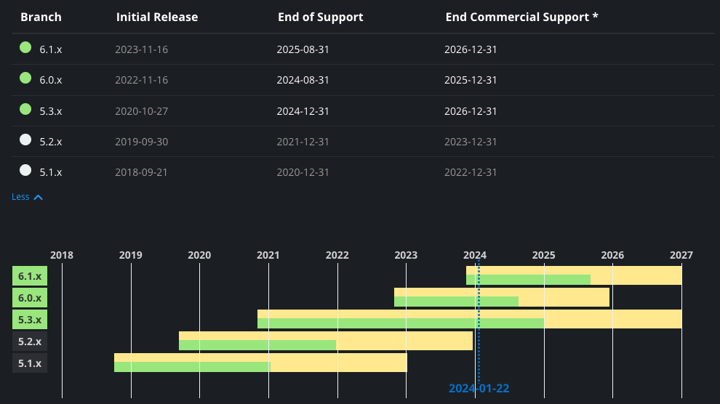
Spring Framework

Slide 5
Projects
From configuration to security, web apps to big data—whatever the infrastructure needs of your application may be, there is a Spring Project to help you build it. Start small and use just what you need—Spring is modular by design.
Spring project

Slide 6
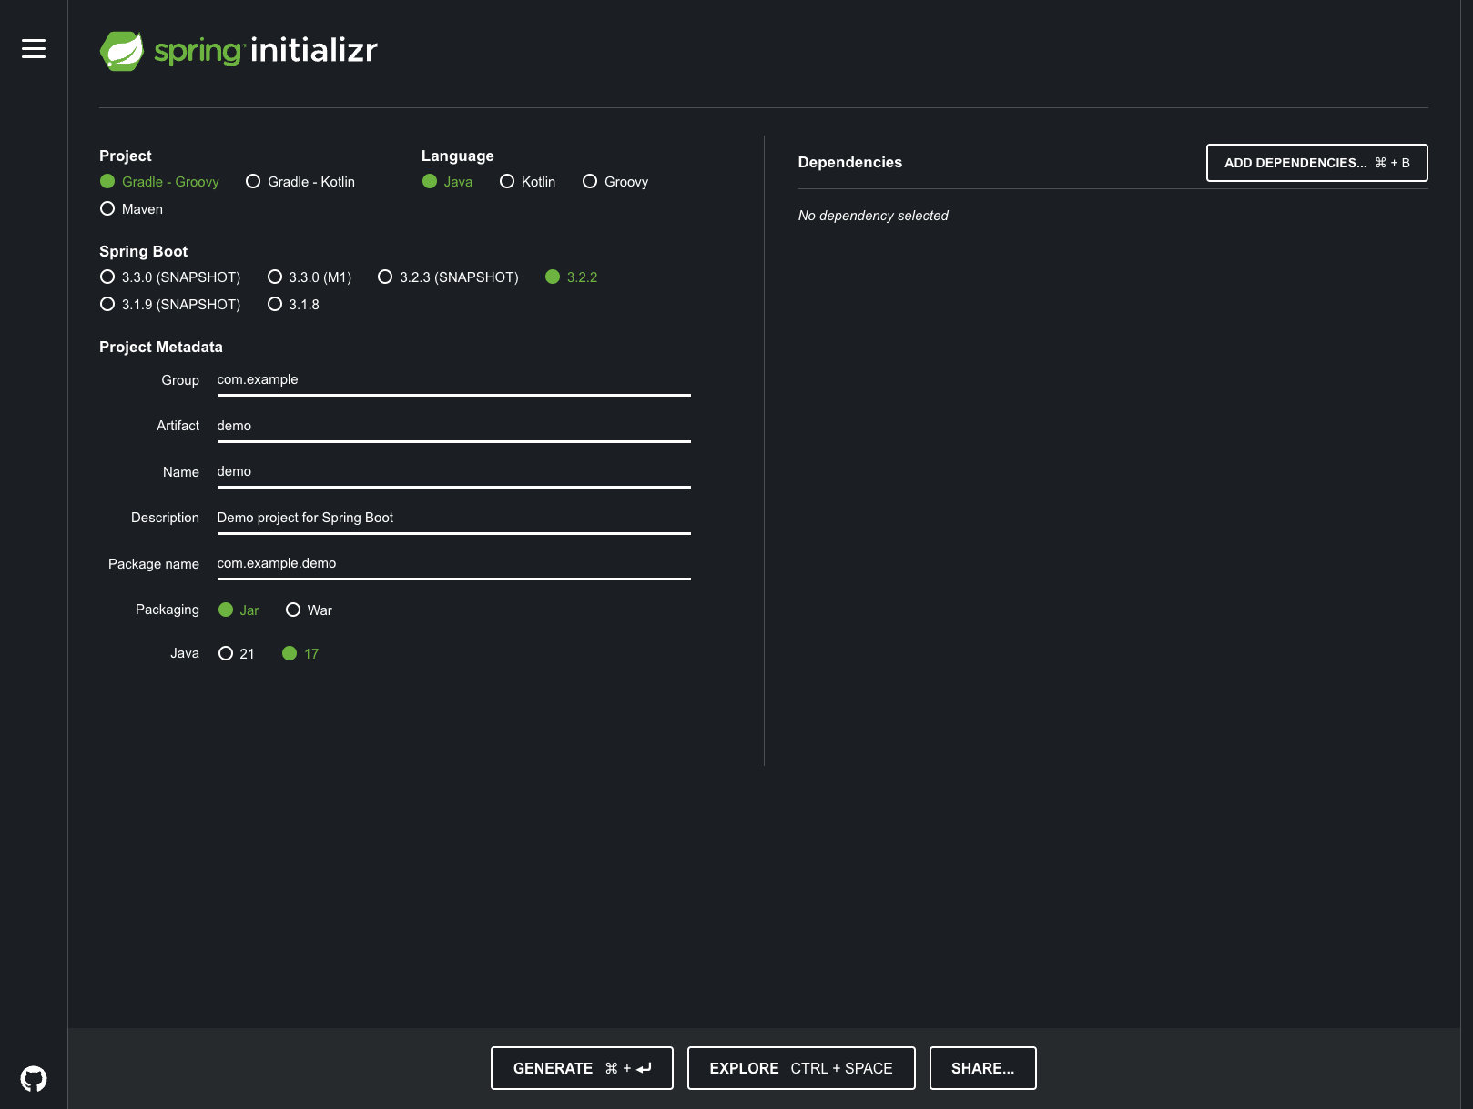
Spring initializr
start spring

Slide 7
Features
Core technologies: dependency injection, events, resources, i18n, validation, data binding, type conversion, SpEL, AOP.
Testing: mock objects, TestContext framework, Spring MVC Test, WebTestClient.
Data Access: transactions, DAO support, JDBC, ORM, Marshalling XML.
Spring MVC and Spring WebFlux web frameworks.
Integration: remoting, JMS, JCA, JMX, email, tasks, scheduling, cache and observability.
Languages: Kotlin, Groovy, dynamic languages.

Slide 8
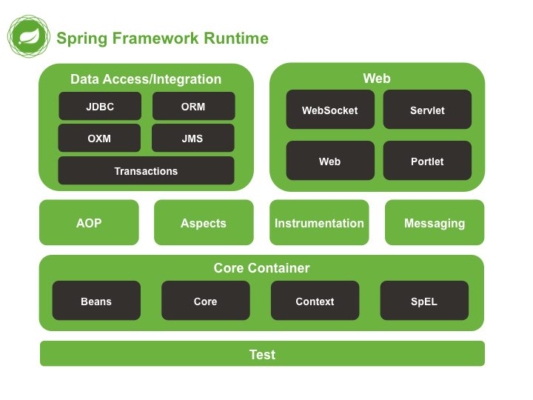
Spring Framework Runtime

Slide 9
Spring Framework - Core Container
The Core module provides the fundamental parts of the framework, including the IoC and Dependency Injection features.
The Bean module provides BeanFactory which is a sophisticated implementation of the factory pattern.
The Context module builds on the solid base provided by the Core and Beans modules and it is a medium to access any objects defined and configured.
The Expression Language module provides a powerful expression language for querying and manipulating an object graph at runtime.

Slide 10
Spring Framework - Data Access
The JDBC module provides a JDBC-abstraction layer that removes the need to do tedious JDBC related coding.
The ORM module provides integration layers for popular object-relational mapping APIs, including JPA, JDO, Hibernate, and iBatis.
The Transaction module supports programmatic and declarative transaction management.

Slide 11
Spring Framework - WEB
Spring's Web MVC (model-view-controller) provides basic web-oriented integration features such as multipart file-upload functionality and the initialization of the IoC container using servlet listeners and a web-oriented application context, also provides a clean separation between domain model code and web forms
The WebFlux reactive-stack web framework, Spring WebFlux, was added later in version 5.0. It is fully non-blocking, supports Reactive Streams, and runs on such servers as Netty, Undertow, and Servlet 3.1+ containers.

Slide 12
Spring AOP
Spring' AOP module provides an AOP Alliance-compliant aspect-oriented programming implementation allowing you to define, for example, method-interceptors and pointcuts to cleanly decouple code that implements functionality that should be separated.
The separate Aspects module provides integration with AspectJ.

Slide 13
Bean
The objects that form the backbone of your application and that are managed by the Spring IoC container are called beans.
A bean is an object that is instantiated, assembled, and otherwise managed by a Spring IoC container. These beans are created with the configuration metadata that you supply to the container, for example, in the form of XML <bean/> definitions which you have already seen in previous chapters.

Slide 14
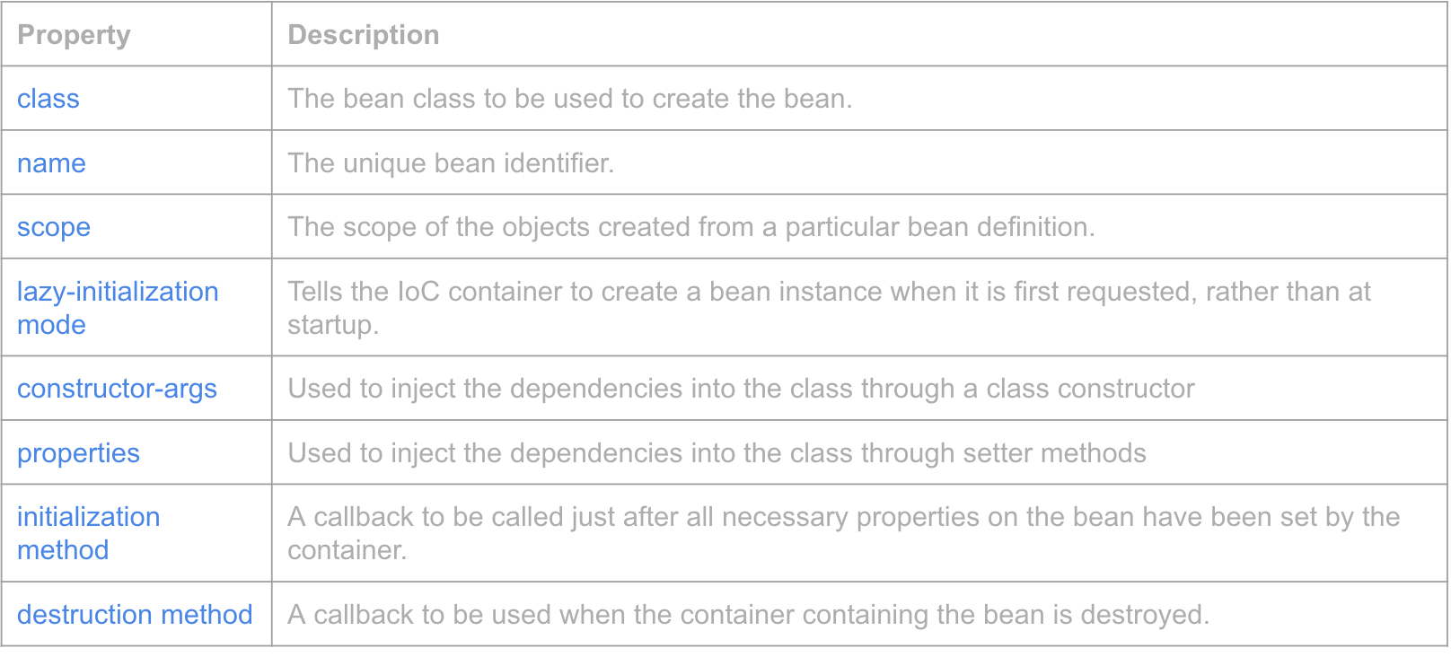
The bean definition

Slide 15
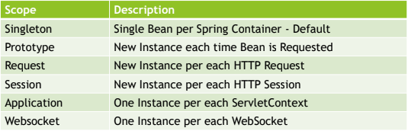
Scope

Slide 16
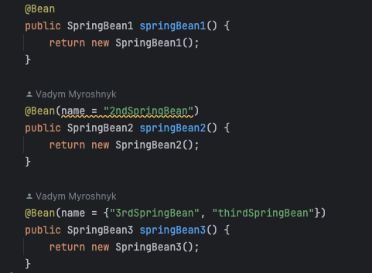
Bean - ID

Slide 17
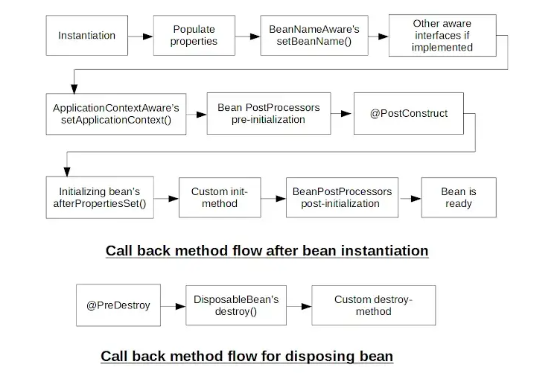
Spring Bean Life Cycle

Slide 18
Bean - initialization method
Initialization method is a method that you can write for Spring Bean if you need
to perform some initialization code that depends on properties and/or
dependencies injected into Spring Bean.
You can declare Initialization method in three ways:
Create method in Spring Bean annotated with @PostConstruct
Implement InitializingBean::afterPropertiesSet
Create Bean in Configuration class with @Bean method and us @Bean(initMethod)

Slide 19
Bean - destroy method
Destroy method is a method in Spring Bean that you can use to implement any
cleanup logic for resources used by the Bean. Method will be called when Spring
Bean will be taken out of use, this is usually happening when Spring Context is
closed.
You can declare destroy method in following ways:
Create method annotated with @PreDestroy annotation
Implement DisposableBean::destroy
Create Bean in Configuration class with @Bean method and use @Bean(destroyMethod)

Slide 20
Container
Container is an execution environment which provides additional technical services for
your code to use. Usually containers use IoC technique, that allows you to focus on
creating business aspect of the code, while technical aspects like communication details
(HTTP, REST, SOAP) are provided by execution environment.
Spring provides a container for beans. It manages lifecycle of the beans and also provides
additional services through usage of Application Context.

Slide 21
Application Context
Application Context is a central part of Spring application. It holds bean definitions and contains registry of application components. It allows you to retrieve assembled and configured beans.
Common Application Context types:
AnnotationConfigApplicationContext
AnnotationConfigWebApplicationContext
ClassPathXmlApplicationContext
FileSystemXmlApplicationContext
XmlWebApplicationContext

Slide 22
Application Context
Initiates Beans
Configures Beans
Assemblies Beans
Manages Beans Lifecycle
Is a Bean Factory
Is a Resource Loader
Has ability to push events to registered even listeners
Exposes Environment which allows to resolve properties

Slide 23
Application Context - new instance
Non-Web Applications:
AnnotationConfigApplicationContext
ClassPathXmlApplicationContext
FileSystemXmlApplicationContext
Web Applications:
Servlet 2 – web.xml, ContextLoaderListener, DispatcherServlet
Servlet 3 – XmlWebApplicationContext
Servlet 3 - AnnotationConfigWebApplicationContext
Spring Boot:
SpringBootConsoleApplication – CommandLineRunner
SpringBootWebApplication – Embedded Tomcat

Slide 24
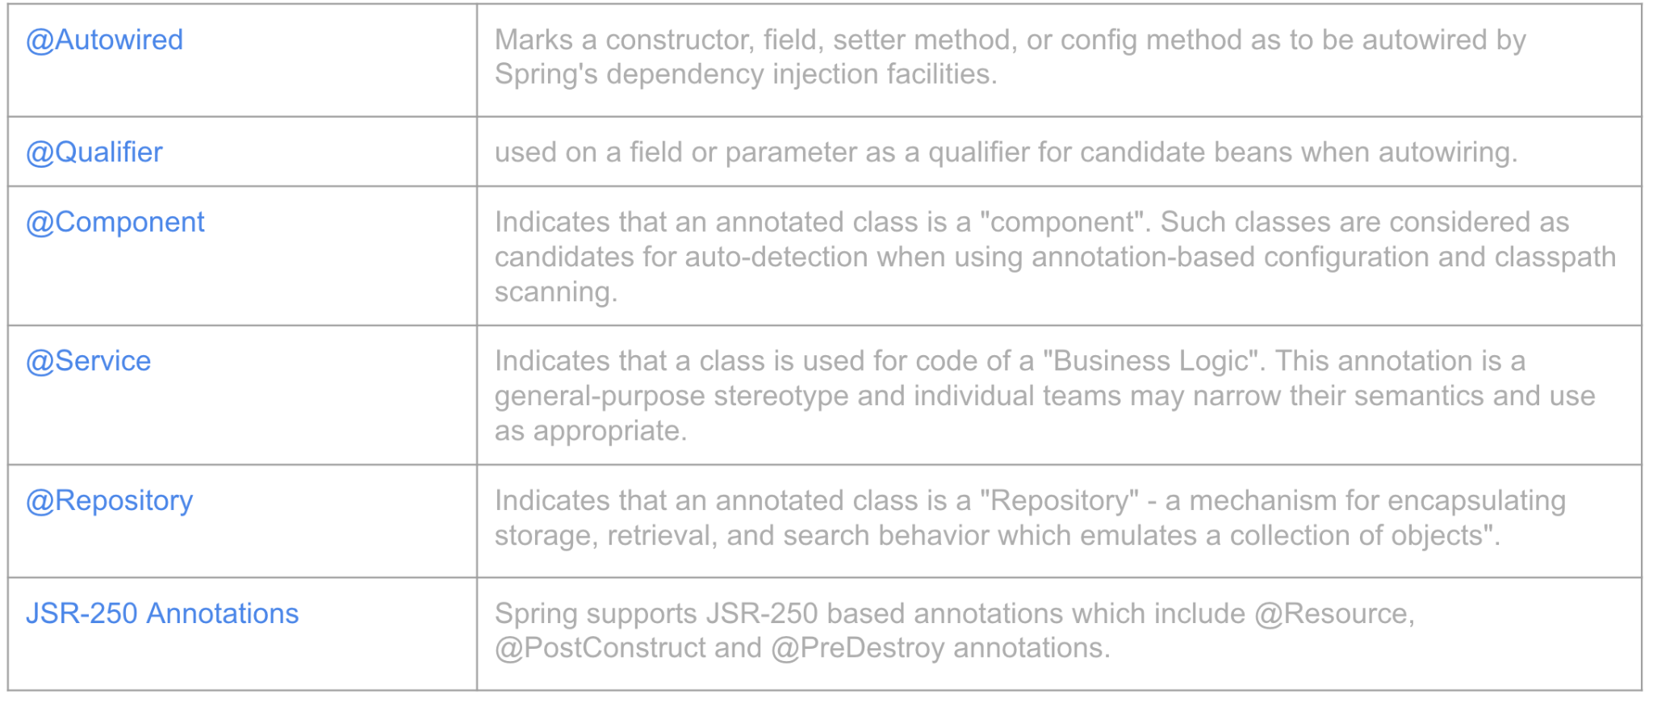
Annotation Based Configuration

Slide 25
Java Based Configuration
@Configuration indicates that the class can be used by the Spring IoC container as a source of bean definitions.
@Bean annotation tells Spring that a method annotated with @Bean will return an object that should be registered as a bean in the Spring application context.

Slide 26
Inversion of Control in Spring
The Spring container is at the core of the Spring Framework.
The Spring container uses dependency injection (DI) to manage the components that make up an application.
The container will create the objects, wire them together, configure them, and manage their complete lifecycle from creation till destruction.
The container gets its instructions on what objects to instantiate, configure, and assemble by reading configuration metadata provided. The configuration metadata can be represented either by XML, Java annotations, or Java code.

Slide 27
What is dependency injection and what are the advantages?
Dependency Injection is a technique of creating software in which objects do not create their dependencies on itself, instead objects declare dependencies that they need and it is external object job or framework job to provide concrete dependencies to objects.

Slide 28
What is dependency injection and what are the advantages?
Types of Dependency Injection:
Constructor injection
Setter injection
Field injection

Slide 29
What is dependency injection and what are the advantages?
Advantages of using dependency injection is:
Increases code reusability
Increases code readability
Increases code maintainability
Increases code testability
Reduces coupling
Increases cohesion

Slide 30
@PropertySource
PropertySource is Spring Abstraction on Environment Key-Value pairs, which can come from:
JVM Properties
System Environmental Variables
JNDI Properties
Servlet Parameters
Properties File Located on Filesystem
Properties File Located on Classpath

Slide 31
@Qualifier
@Qualifier annotation gives you additional control on which bean will be injected, when
multiple beans of the same type are found. By adding additional information on which bean you
want to inject, @Qualifier resolves issues with NoUniqueBeanDefinitionException.
You can use @Qualifier in three ways:
At injection point with bean name as value
At injection and bean definition point
Custom Qualifier Annotation Fefinition

Slide 32
Profiles
Spring Profiles are useful in following cases:
Changing Behavior of the system in Different Environments by changing set of Beans that are part of specific environments, for example prod, cert, dev
Changing Behavior of the system for different customers
Changing set of Beans used in Development Environment and also during Testing Execution
Changing set of Beans in the system when monitoring or additional debugging capabilities should be turned on

Slide 33
SpEL
Spring Expression Language (SpEL) is an expression language that allows you to query and manipulate objects graphs during the runtime. SpEL is used in different products across Spring portfolio.
SpEL can be used independently with usage of ExpressionParser and EvaluationContext or can be used on top of fields, method parameters, constructor arguments via @Value annotation @Value("#{ ... }").

Slide 34
@Value
To inject scalar/literal values into Spring Beans, you need to use @Value annotation.
@Value annotation has one field value that accepts:
Simple value
Property reference
SpEL String
@Value annotation can be used on top of:
Field
Constructor Parameter
Method – all fields will have injected the same value
Method parameter – Injection will not be performed automatically if @Value is not present on method level or if @Autowired is not present at method level
Annotation type

Slide 35
Q&A

